Slide 1

WEBPROFILER AI
Deep Learning
Mastering Neural Networks
Mariano Somoza – 2023

Slide 2
AGENDA
INTRODUCTION
PROBLEM DESCRIPTION
DATA DESCRIPTION
METHODOLOGY
MODEL EVALUATION
RESULTS AND VISUALIZATIONS
CONCLUSIONS
REFERENCES
WEBPROFILLER AI

Slide 3
INTRODUCTION
Context: The importance of penetration testing in cybersecurity
Motivation: Streamlining the reconnaissance phase in pentesting.
Project Goal: Develop a tool to automatically classify websites based on visual features (screenshots)
Benefits:
Target prioritization: Focus on relevant or vulnerable sites.
Automation and efficiency: Save time and resources in the reconnaissance phase.
Anomaly identification: Detect unusual website features.
Phishing page detection: Identify potential phishing attacks and spoofed websites.
WEBPROFILLER AI

Slide 4
problem description
WEBPROFILLER AI

Slide 5
problem description
Problem Statement: Develop an automated tool to classify websites into four categories based on screenshots: 'Custom 404 pages', 'Login pages', 'Old-looking websites', and 'Parked domains’.
Importance of Problem:
In the cybersecurity field, penetration testing is crucial for identifying and addressing vulnerabilities in systems and applications.
A significant step in the penetration testing process is reconnaissance, which involves gathering information about target systems to identify potential attack vectors.
Reducing the time spent on manual analysis during the reconnaissance phase is essential for improving the efficiency of the process.
WEBPROFILLER AI

Slide 6
problem description
Applications in Industry and Research:
Cybersecurity Industry: An automated website classification tool can streamline the reconnaissance process, enabling security professionals to prioritize targets, focus on more critical aspects, and identify unusual features or phishing attempts.
Machine Learning Research: Developing such a tool challenges researchers to create algorithms and models that can effectively recognize and categorize websites based on visual features, contributing to advancements in the field of computer vision and image classification.
Web Analytics and Marketing: Beyond cybersecurity, this tool can be applied in other industries, such as web analytics and digital marketing, to understand user behavior, identify trends, and optimize website performance.
WEBPROFILLER AI

Slide 7
problem description
Website classification categories:
Custom404: Unique error pages with helpful info or navigation.
Login: Pages requiring credentials; targeted by attackers.
OldLooking: Outdated designs/layouts; potential security vulnerabilities.
Parked: Domain placeholders: domain takeover security risk, minimal content.
WEBPROFILLER AI

Slide 8
data description
WEBPROFILLER AI

Slide 9
DATA description
Data Source:: Modified Kaggle dataset - Pentest Screenshots (https://www.kaggle.com/datasets/altf42600/pentest-screensots)
Dataset Modification: Rearranged files into separate folders for each category, improving flexibility and ease of use during the training process.
Dataset Characteristics:
Number of Samples: 11268
Image Resolution: 1440 x 900 pixels (16:10)
File Format: png
Class Distribution:
Custom 404 Pages: 4133
Login Pages: 4554
Old-looking Websites: 1872
Parked Domains: 709
WEBPROFILLER AI

Slide 10
DATA description
Data Preprocessing
Resizing and normalization: All images were resized to 224x224 resolution and normalized with mean=[0.485, 0.456, 0.406] and standard deviation=[0.229, 0.224, 0.225] for VGG-11 compatibility.
Data Augmentation: Techniques such as random cropping, flipping, and zoom were applied to increase dataset size and improve model generalization.
Train/Validation/Test Split: The dataset was split into training, validation, and testing sets to train the model, fine-tune hyperparameters, and evaluate its performance.
WEBPROFILLER AI

Slide 11
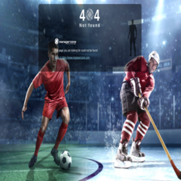



DATA description
Samples
CUSTOM 404
LOGIN
OLD LOOKING
PARKED
WEBPROFILLER AI

Slide 12
Methodology
WEBPROFILLER AI

Slide 13
Methodology
Data Preparation:
Split dataset into training (60%), validation (20%), and test (20%) sets
Applied data augmentation techniques such as random resized crops, color jitter, random erasing, and horizontal flips to the training set
Normalized all images and resized them to 224x224 pixels
Pre-trained VGG-11 Model:
Utilized a pre-trained VGG-11 model on the ImageNet dataset as the starting point
Modified the last fully connected layer to match the number of target classes (4 categories: 'custom404', 'login', 'oldlooking', 'parked’)
Two-phase training process:
Phase 1: Kept the pre-trained layers fixed and only trained the newly added classification layer using the Adam optimizer and Cross-Entropy Loss
Phase 2: Unfroze all layers and trained the entire network using the Adam optimizer and Cross-Entropy Loss
WEBPROFILLER AI

Slide 14
Methodology
Hyperparameters
Learning rate: 0.001
Epochs: 25 per training phase (50 total)
Batch size: 100
L1 regularization with lambda of 1e-4
L2 regularization with weight decay of 1e-4
Dropout: Experimented with modifying dropout, but ultimately kept the original value of 0.5
Training Process:
Trained the model for 25 epochs in each phase
Implemented L1 and L2 regularization
Monitored accuracy and loss during training
Model Evaluation:
Evaluated the fine-tuned model on the validation and test sets to measure its performance
Monitored accuracy, loss, and potential overfitting during training
Constructed confusion matrices for model evaluation
Generated loss and accuracy plots to visualize model performance over epochs
WEBPROFILLER AI

Slide 15
RESULTS

Slide 16
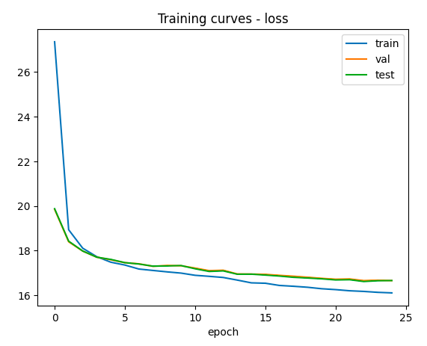
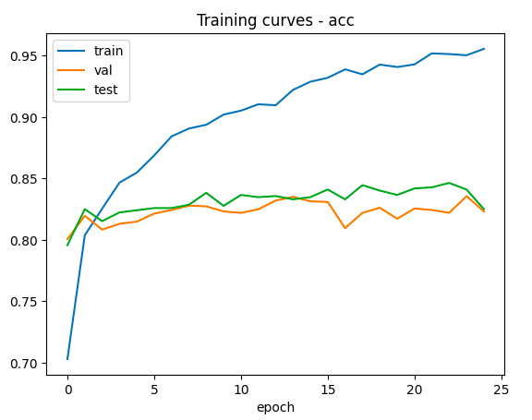
RESULTS – PHASE 1
Phase 1 – Results
Epoch with the best validation accuracy: 23
Training accuracy: 95.55%
Validation accuracy: 83.56%
Test accuracy: 82.50%
Problems: Overfitting

Slide 17
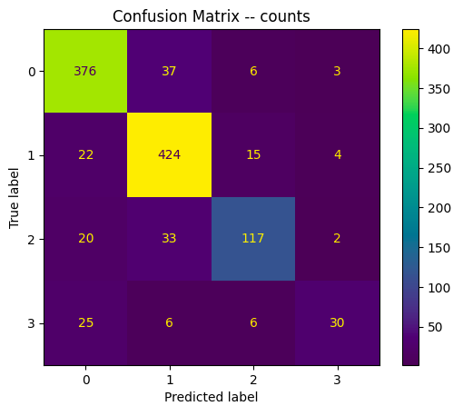
RESULTS – PHASE 1
Phase 1 – Results – Confusion Matrix
Features: ['custom404', 'login', 'oldlooking', 'parked’]
Model performs well overall.
Best predictions for 'login' (424 true positives).
Lower predictions for 'parked' (30 true positives).
Misclassifications between 'custom404' and 'login' classes.
Room for improvement, especially for 'oldlooking' and 'parked' classes.

Slide 18
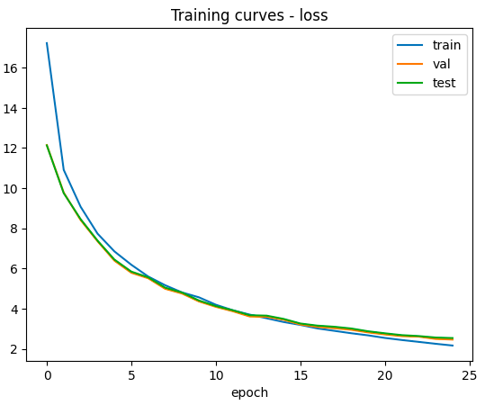
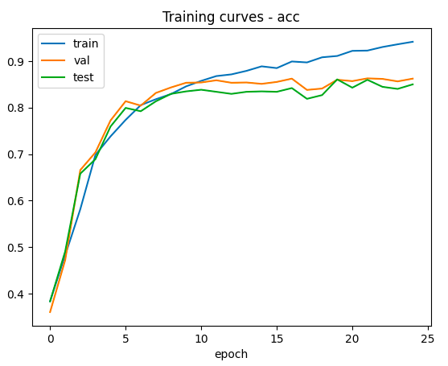
RESULTS – PHASE 2
Phase 2 – Results
Epoch with the best validation accuracy: 21
Training accuracy: 92.19%
Validation accuracy: 86.28%
Test accuracy: 84.46%
Problems: Overfitting?

Slide 19
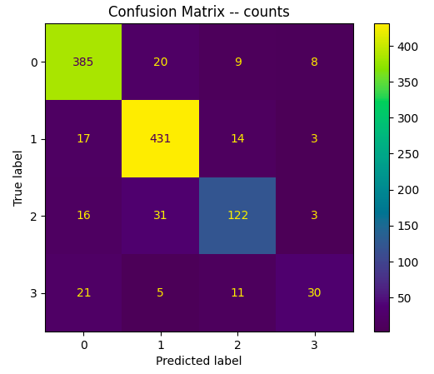
RESULTS – PHASE 2
Phase 2 – Results – Confusion Matrix
Features: ['custom404', 'login', 'oldlooking', 'parked']
Improved performance compared to Phase 1.
Best predictions for 'login' (431 true positives).
Lower predictions for 'parked' (30 true positives).
Reduced misclassifications between 'custom404' and 'login' classes.
Still room for improvement, especially for 'oldlooking' and 'parked' classes.

Slide 20
Conclusions

Slide 21
Conclusions
Summary of key findings and results:
We implemented a two-phase transfer learning approach for image classification using a pre-trained VGG-11 model.
The model achieved high accuracy in both phases, but overfitting was observed.
The dataset was modified to assign only one category per image, which may have affected the classification results.
Limitations of the model and approach used.
Overfitting occurred in both phases of training, which may reduce the model's generalization capability on new, unseen data.
The model may struggle to generalize well on images that significantly differ from the training set.

Slide 22
Conclusions
Possible improvements and future work:
Experiment with additional data augmentation techniques to improve generalization.
Fine-tune hyperparameters, such as learning rate, weight decay, and dropout, to reduce overfitting.
Investigate the impact of using different pre-trained models or architectures.
Further refine the dataset and labeling process to ensure accurate and consistent classification.
Expand the dataset to include more screenshots of known vulnerabilities and issues, such as directory listing, SQL injection, stack trace, and some JavaScript obfuscation.

Slide 23
THANK YOU

